Slide 1
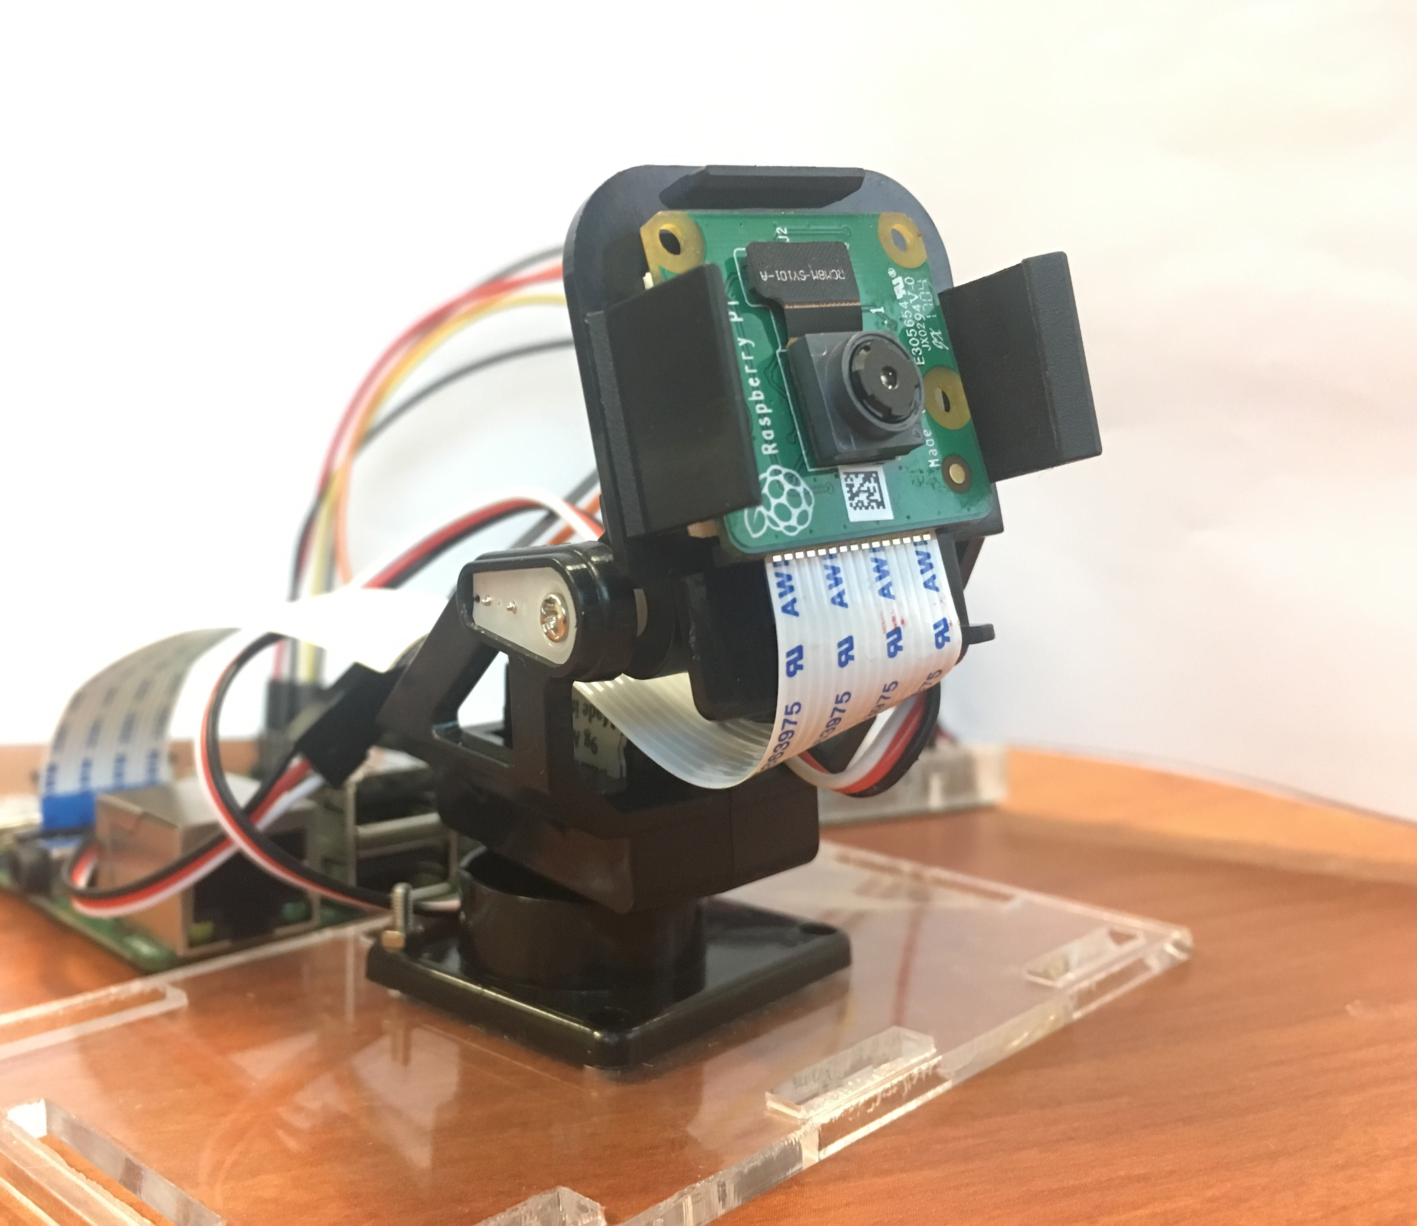
Object Detection And Tracking
Vignesh Jayaram
Vihanga Bare
Vishal Vishnani

Slide 2
Presentation Roadmap
Introduction
Block Diagram
State Machine
Control Flow Diagram
Capability Requirements
Real Time Requirements
Worst Case Execution Time
Feasibility Analysis
Cheddar & RM LUB Analysis
Verification Plan
Proof-of-concept
Challenges Faced
Demo
Conclusion

Slide 3
Introduction
Objective
Applications
To be able to detect circular shaped object contours based on hue and saturation values
Detect this object and calculate its centroid
Use Kalman Filter to track this object’s position along X and Y Axes
Depending on displacement along X and Y axes, control two servo motors to track the object and keep it within camera’s field of vision
Aid Real time video surveillance applications and facilitate minimum human intervention
ECEN 5623 | Object detection and tracking system | Vignesh, Vihanga, Vishal
May 1, 2018
3

Slide 4
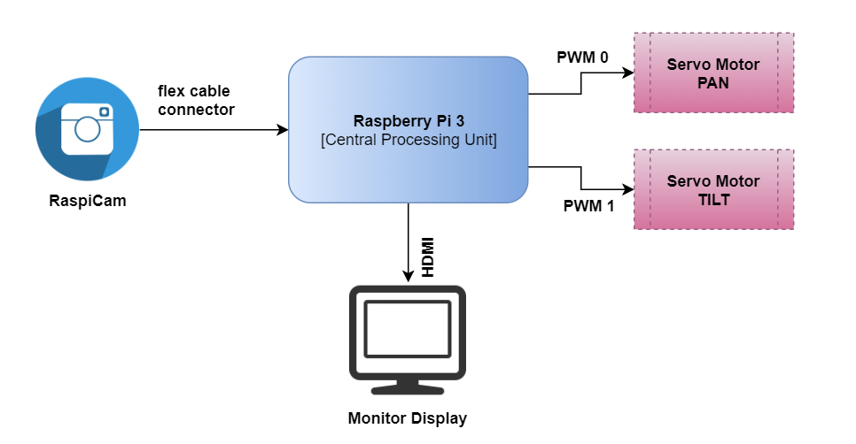
Block Diagram
ECEN 5623 | Object detection and tracking system | Vignesh, Vihanga, Vishal
May 1, 2018
4

Slide 5
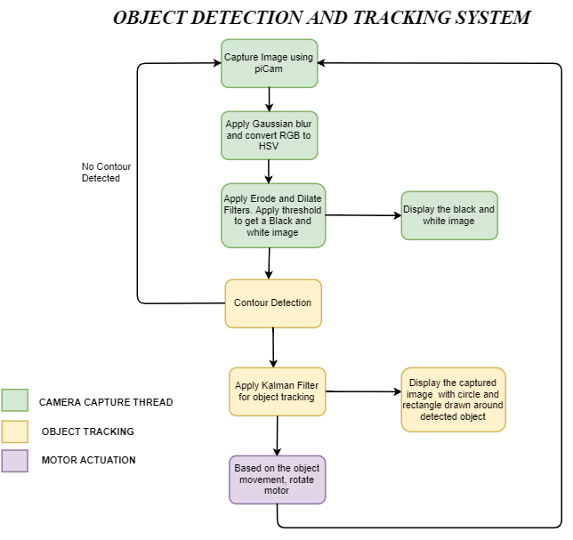
State Diagram

Slide 6
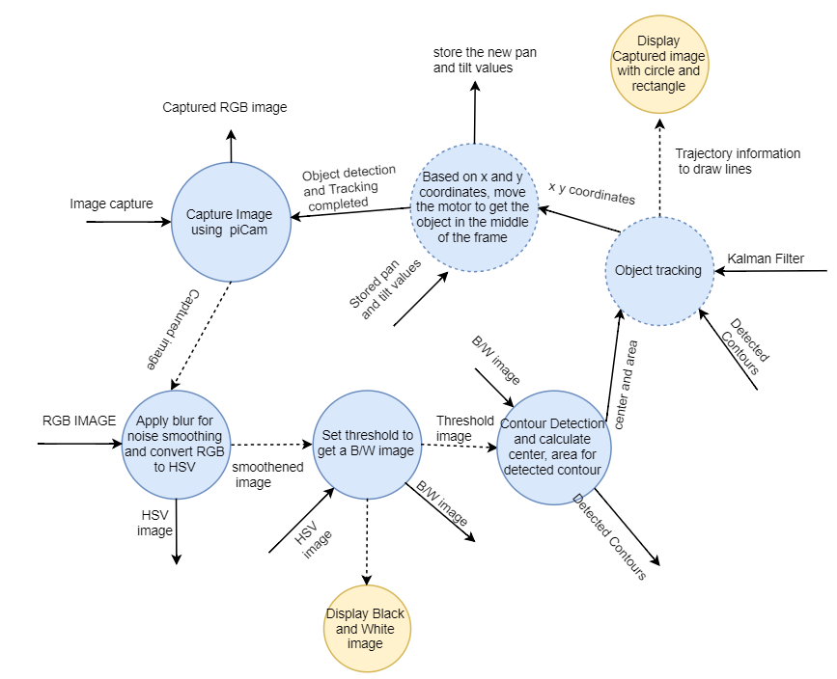
Control Flow Diagram

Slide 7
Capability Requirements
The system should be able to interface successfully with the Raspberry Pi Camera and should capture still frame as well as live video feed with minimal lag.
The system should be able to detect the targeted object on the basis of hue, saturation selected and threshold values set.
Once detected, the system should successfully extract the detected object from its background using contour detection.
Detection of targeted object is followed by accurate calculation of object’s center, its area.
Using center coordinates, our system should map the displacement along X and Y axes to control rotations of two servo motors using PWM.

Slide 8
Real time Requirements
With a capture rate averaging over 5 frames per second, our system meets the deadline requirements of standard video surveillance applications.
Detect objects with speed in range of 1.3 to 1.6 m/s
SCHED_FIFO scheduling of tasks and binary semaphores for synchronization
Camera capture service to take camera feed as input, apply pre processing filters and display threshold output within 185 msecs
Service for object detection, usage of Kalman Filter to track object based on the co-ordinates of its centroid within 10 msecs
Motor actuation service controls two servo motors to produce pan and tilt movements, keeps targeted object within camera’s field of vision within 20 msecs

Slide 9
Worst Case Execution Time
For our system is soft real time we calculated ACET and WCET for each service
Per our analysis for 100 frames using ACET, only 2 out of 100 frames were found to miss deadline
Thus, we considered ACET as our completion time (Ci) for each service. Ci for our three services is 177 ms, 7 ms, 18 ms
Considering margins for each service, we arrived at deadlines of 185 ms, 10 ms, and 20 ms (total margin 6 %) and total frame execution time of 215 ms
Achieved frame rate of 5 frames per second which meets soft real time deadlines observed in video surveillance applications

Slide 10
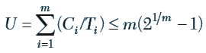
Feasibility Analysis
Utilization factor by RM LUB Analysis
For our service set, (C1/T1) + (C2/T2) + (C3/T3)
= (177/215) + (7/215) + (18/215)
= 0.9395 (94%)
m(2^{(1⁄m)} -1) = 3(2^{(1⁄3)} -1) = 0.78 = (78%)
RM LUB is not satisfied however it only a sufficient test
Our service set is FEASIBLE by Scheduling point and Completion time tests which are necessary and sufficient for feasibility
Ref: Real Time Embedded Systems by Prof. Sam Siewert

Slide 11
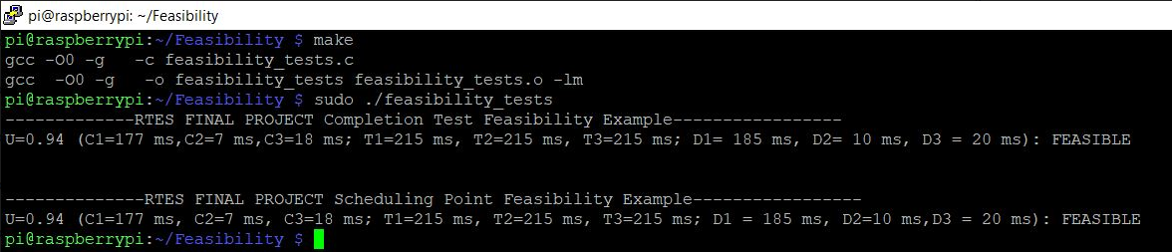
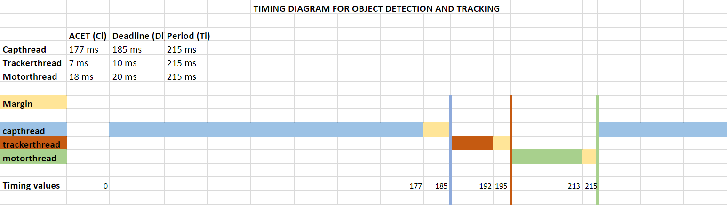
Feasibility Analysis
Scheduling Point and Completion Time Test Results
Timing Diagram

Slide 12
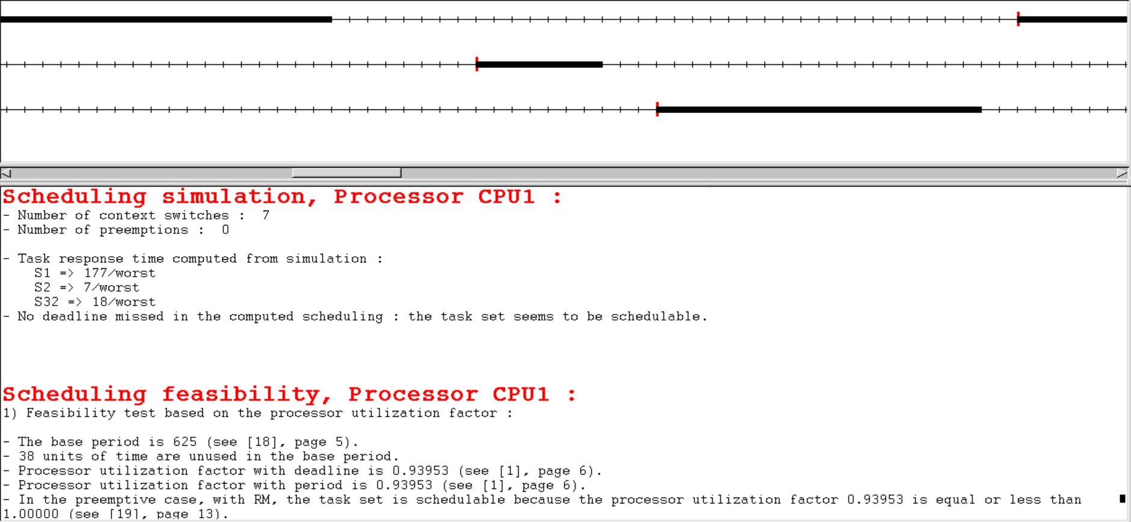
Feasibility Analysis
Cheddar Analysis Results

Slide 13
Proof-of-concept
Raspberry Pi Model B for development board with following features:
Quad Core 64 bit ARM Cortex A5
5 MP Raspberry Pi Camera module with Camera Serial Interface
Broadcom GPIO pinout for interfacing with servo motors
OpenCV C++ library features of BGR to HSV, Threshold, Contour detection, Kalman Filter
Usage of OpenMP libraries for parallel execution of certain functions
Two 9g Micro servo motors (0 to 180 deg) for movements across X and Y axes
C++ API for interfacing with RPi Cam, GPIO access C library for RPi
Camera mount to facilitate Pan and Tilt movements

Slide 14
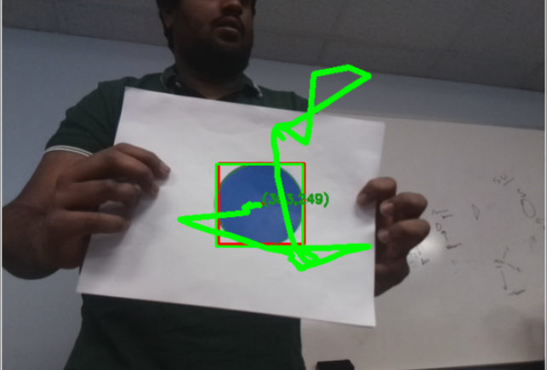
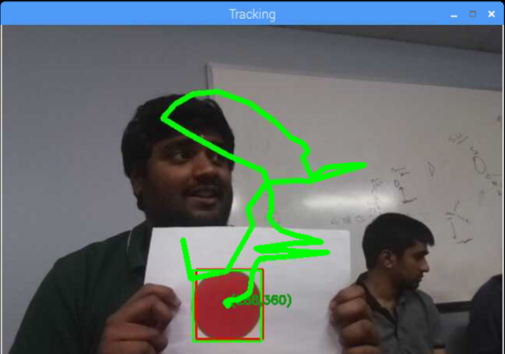
Proof-of-concept: Prototype implementation
System detecting and tracking circular shaped object of ‘Red’ and ‘Blue’
Low light conditions – ESE Lab

Slide 15
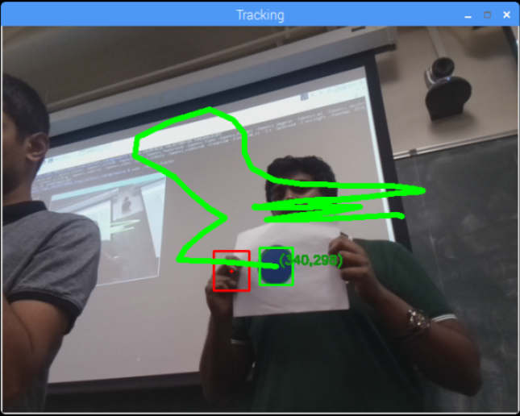
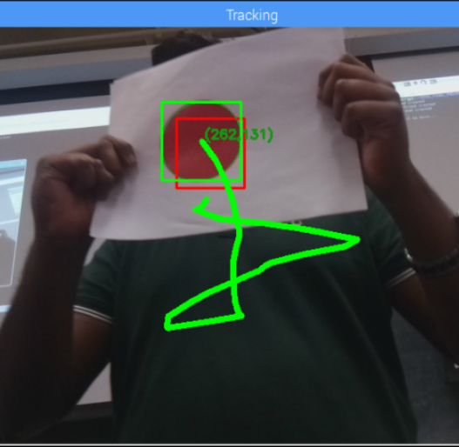
Proof-of-concept: Prototype implementation
System detecting and tracking circular shaped object of ‘Red’ and ‘Blue’ colors in
Good light conditions – ECCR 1B51

Slide 16
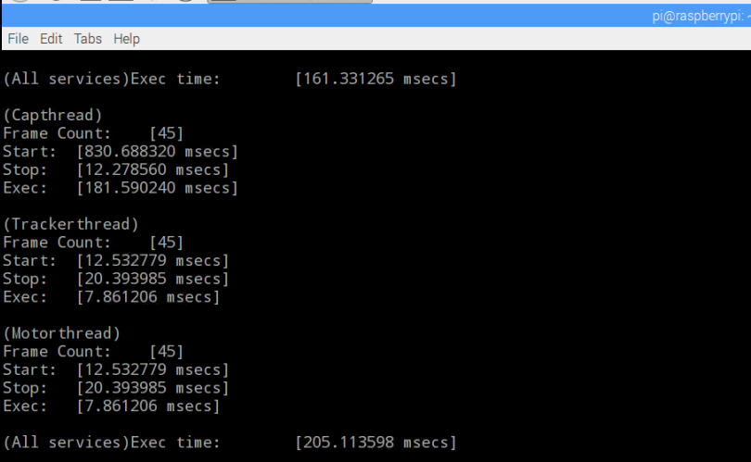
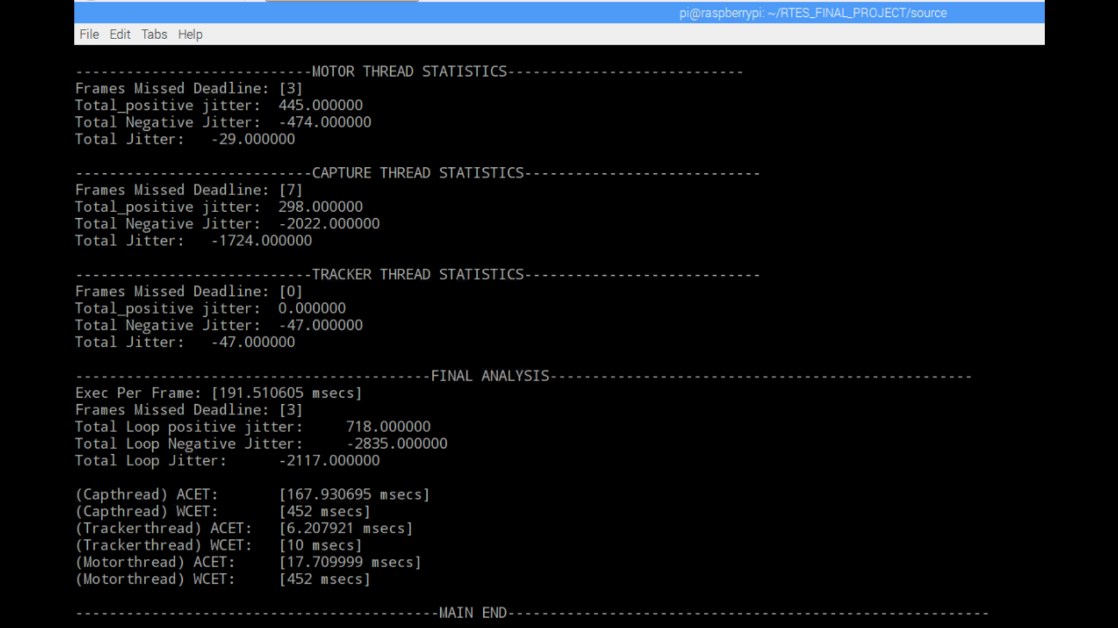
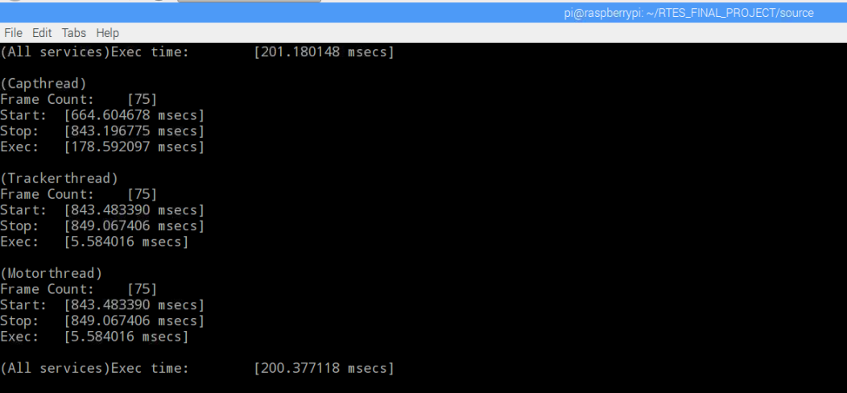
Proof-of-concept: Time Stamp tracing

Slide 17
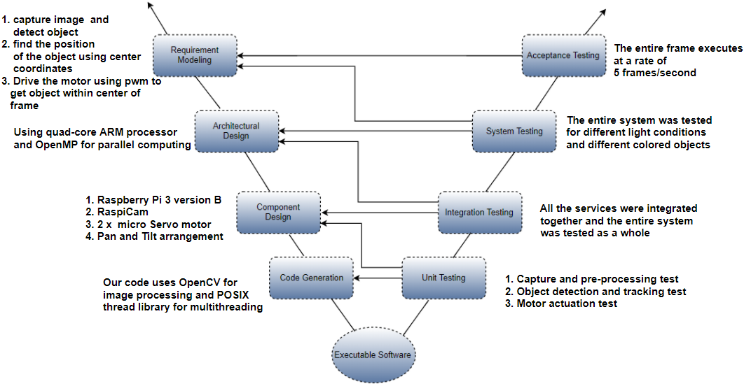
Verification Plan

Slide 18
Challenges Faced
Installation and setup of OpenCV C++ environment for the Linux distribution on Raspberry Pi
The detection of a particular color varies according to different test environments like low/good light conditions, shadow areas
For a more efficient detection, we had to program the threshold filter to accept a range of hue/saturation values for different colors
The system tracks an object with speed in range of 1.3 to 1.6 m/s, we found it challenging to track higher speeds accurately

Slide 19
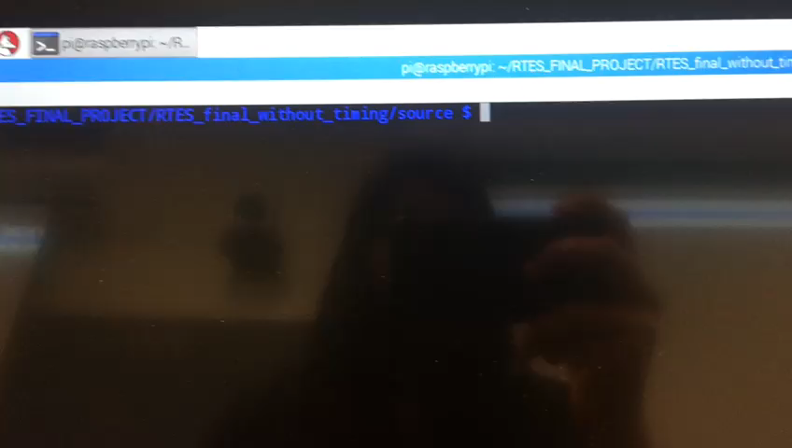
Demo

Slide 20
Thank You
Q & A

